Slide 1
GCC Target Evaluation
Confidential 1

Slide 2
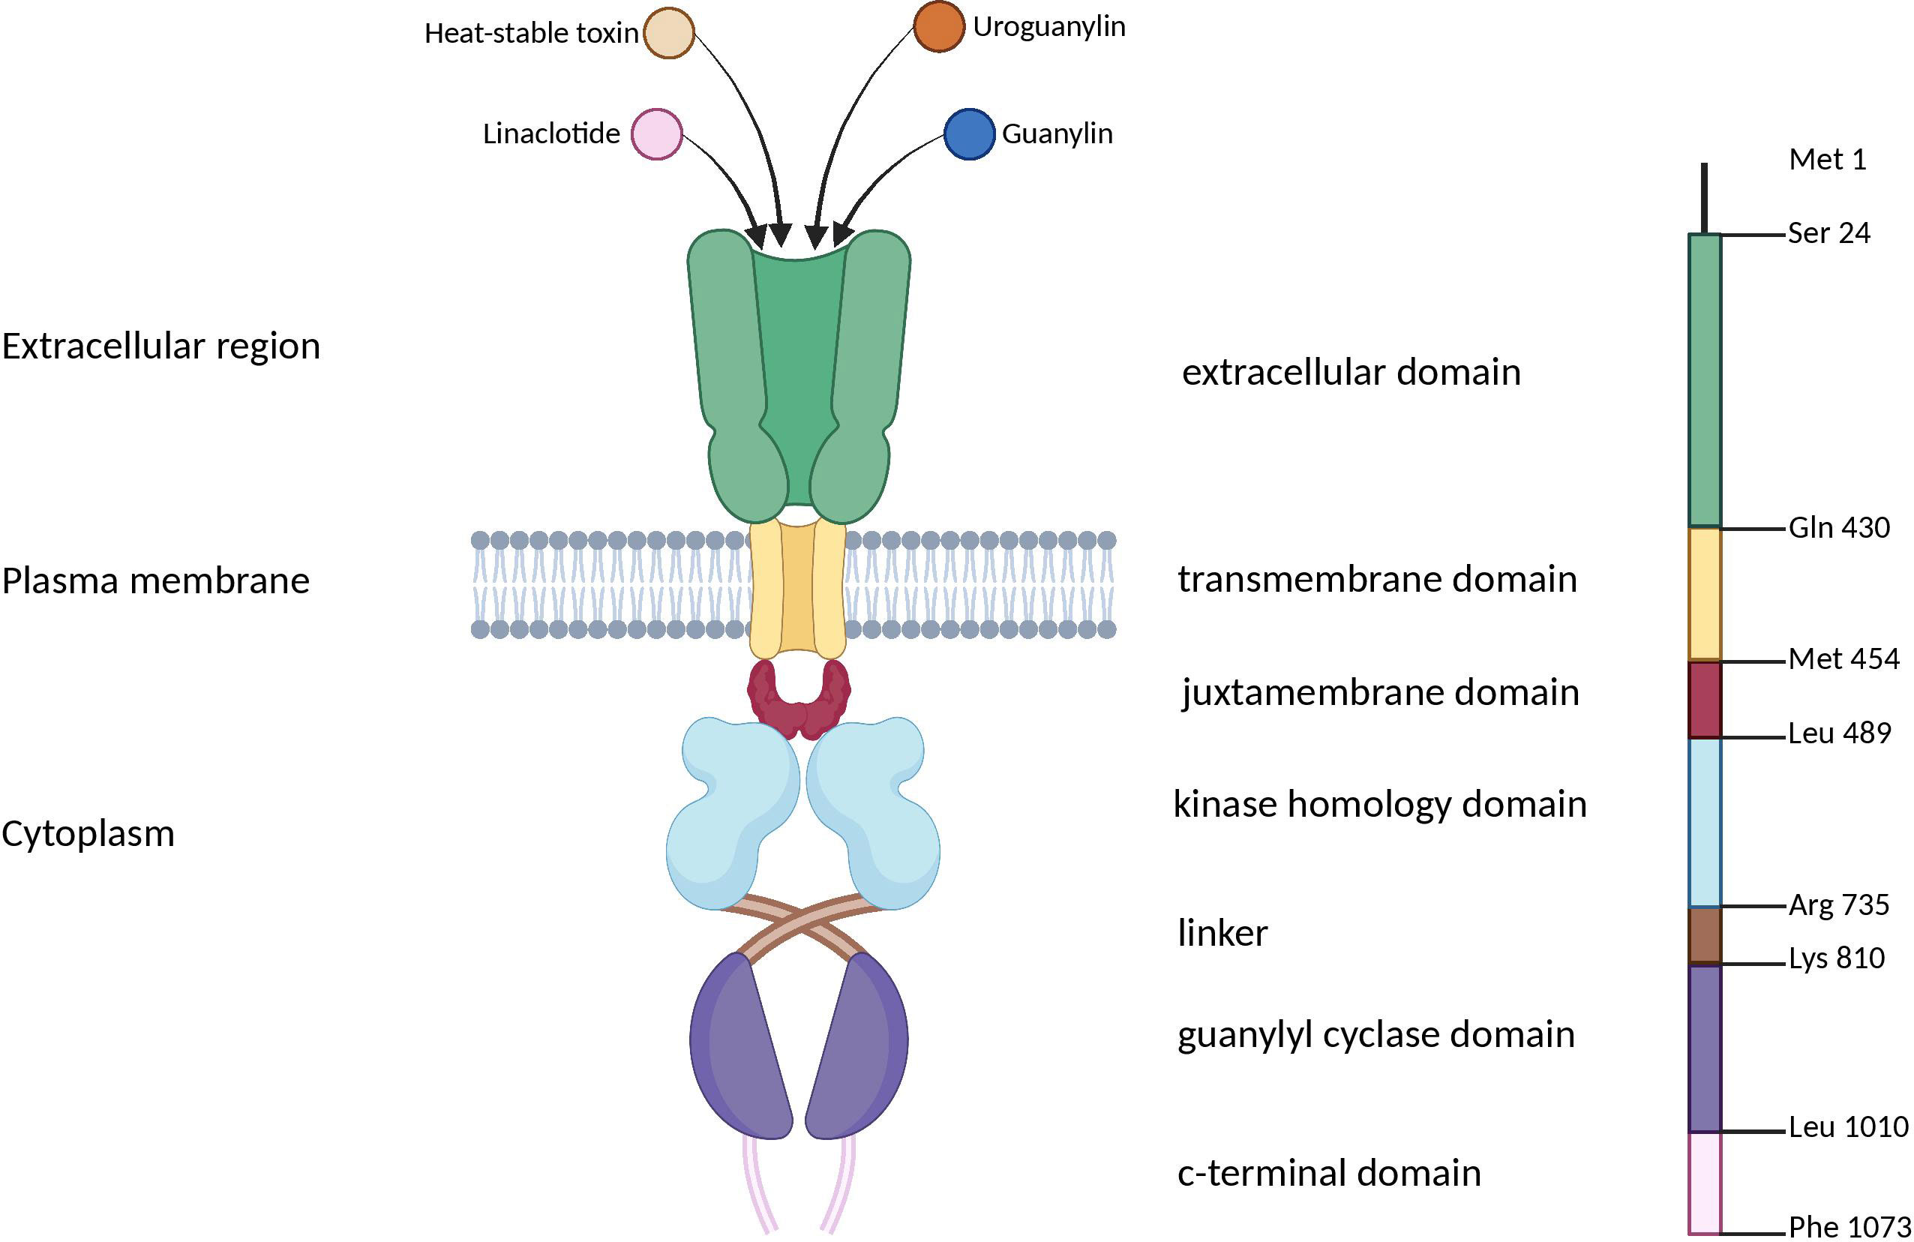
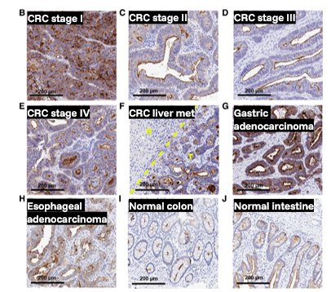
GCC is highly expressed in CRC and has endogenous peptide ligands
Target Selection
Expression
Biology & Feasibility
Tumor-specific accessibility | ✓ | Apical in normal gut, No polarization in tumors
Internalization | ✓ | Natively internalized, rapid
Secretion | ✓ | No secretion
Ligandability | ✓ | Natively binds peptide ligands, agonist peptides are approved for constipation
IHC studies demonstrate:
Strong positivity in 70-98% of CRC tumors
Maintenance of positivity in matched liver metastases in 81% of patients
Evidence of overexpression in gastric, esophageal, pancreatic tumors
Healthy tissue expression in GI tract and some epithelial cells that is shielded by apical localization
Landscape
No GCC RLT in active development by industry, to our knowledge
Sego’s Approach
Modality | GCC active or allosteric site targeted peptide RLT
Positioning | Stage II/III CRC, post surgery MRD+ patients replacing current chemo adjuvant therapy
Sources Mathur Clin Cancer Res 2020, Danaee PLOSone 2017, Lisby, Expert Rev Precis Med Dru Dev 2021 Marszalowicz Oncotarget 2014

Slide 3
Overview
GCC programs across modalities suggest targetability, but therapeutic window has been constrained by immune-format and GI toxicities
CAR-T programs
ADC & bispecific programs
Implications for RLT
GCC19CART / LYL273 — Lyell; CoupledCAR platform. Ph 1 CARAPIA-1; CRS in most pts (primarily Gr 1–2); ICANS observed (incl. ≥Gr 3 in updated data); diarrhea common; updated data include serious GI toxicity (enterocolitis) and infection-related events; ~73.7% DCR in refractory mCRC (early dataset)
IM96 — Beijing ImmunoPharm. Standalone GUCY2C CAR-T; Ph 1; 73.7% DCR; high potential in pts with liver mets (ASCO 2024)
XKDCT080 / REVO-UWD-01 — Additional autologous & allogeneic (off-the-shelf) programs in Ph 1
Key signal: CRS/ICANS are common features of CAR-T programs; GI toxicity (incl. diarrhea / enterocolitis) also frequent and may be target and/or modality mediated
MLN0264 / TAK-264 — Indusatumab vedotin. Ph 2 gastric/GEJ; manageable safety but ORR ~6%; discontinued due to limited clinical efficacy
TAK-164 — Takeda. Ph 1 FIH; discontinued; limited clinical activity at tolerated doses
HDP-201 — Heidelberg Pharma; exatecan. Complete tumor remission preclinically (AACR 2025); seeking partner for clinical development
PF-07062119 — Pfizer; GUCY2C×CD3 TCE. Ph 1 completed late 2023; diarrhea 73%, DLTs ~10% include CRS, colitis; discontinued following limited therapeutic window
Key signal: ADC failures driven by limited therapeutic window (low efficacy, DLTs). GI effects in TCE format likely T-cell activation class-effect. Therapeutic window for ADC/TCE too narrow for GCC, may be overcome by RLT.
No epithelial destruction signal — cyno tox showed no erosions or necrosis in intestinal tract; GI symptoms in immune formats likely a mix of modality/payload mediated.
Apical restriction and 1st pass kinetics of RLT will increase therapeutic window — short half life of RLT will differentiate malignant and healthy tissues; enabling sufficient RLT uptake in tumors and sparing radiosensitive tissues (e.g., bone marrow and kidneys)
RLT avoids immune-mediated toxicities —CRS and ICANS are not typically associated with RLT. RLT works via direct cytotoxic radiation damage to DNA; does not trigger CRS or massive activation of immune cells
Rapid Internalization, recycling, and intracellular retention - can overcome low copy number of cell surface receptors by increasing the total amount of radioactive payload delivered into the cell.
Sources: Beacon Intelligence, Company presentations
Confidential 3

Slide 4
GCC Details
Confidential 4

Slide 5
Summary: GCC is an attractive RLT target due to its native peptide ligands, consistent overexpression in CRC, and tumor-specific availability
Biology
GCC (GUCY2C) is a mucosal guanylin cyclase transmembrane receptor, with multiple native peptide ligands. In healthy tissues, its expression is largely restricted to the apical surface of intestinal epithelium and colon. This polarization is lost in tumor cells, selectively exposing GCC to targeted therapy. Importantly, GCC is rapidly internalized into lysosomes in cancer cells, independent of ligand binding, which supports its suitability for RLT.
GCC is overexpressed in approximately 70-98% of colorectal cancers and overexpression is consistently maintained across all disease stages and metastatic sites. Expression in other GI cancers (gastric, pancreatic, esophageal) is also significant, while healthy tissue expression outside the intestine is of minimal concern for RLT (e.g. CNS tissue)
GCC is amenable to peptide-based targeting, with FDA-approved synthetic peptides (linaclotide, plecanatide) already in clinical use for non-oncology GI disorders. Recombinant production is straightforward, and multiple CRC cell lines express GCC, enabling robust preclinical evaluation. ADCs targeting GCC have passed Ph 1, further de-risking RLT development.
No peptide-based RLTs are in obvious active development. CAR-T programs, while abundant, prove targeting GCC can drive efficacy alongside significant toxicities. GCC RLTs will be more tolerable and equally efficacious. GCC RLT could be used in many points in mCRC treatment pathways, which includes chemo, IO, anti VEGFs and emerging ADC therapies. Given the prevalence of mCRC & expression of GCC across most patients and all stages, there is ample unmet need.
Expression
Feasibility
Landscape
Sego’s Opportunity
Design a Best in Class, peptide-based RLT that is internalized and released into the cell, driving higher uptake, longer retention & stronger efficacy against target that is consistently & selectively overexpressed in majority of CRCs
Confidential 5

Slide 6
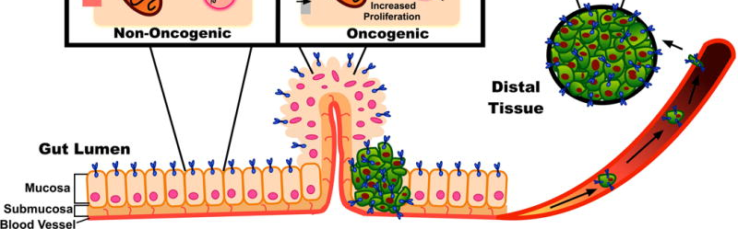
Biology
GCC is secluded in gut lumen in healthy tissue, but selectively blood accessible in tumors
Inside the colon
GCC is secluded to the apical side of the epithelial brush border facing the lumen throughout the entire length of the gastrointestinal tract, from duodenum to rectum but is NOT accessible from the blood.
Protection from blood reduces potential on-target, off-tumor exposure in healthy tissue.
During tumorigenesis, cells undergo a loss of apical-basolateral polarization which leads to GCC expression on the cancer cell surface. GCC on tumor cells is available for binding by RLT & other therapeutic modalities.
Apical target expression in normal epithelium => inaccessible
Target overexpression on the entire tumor cell membrane => accessible
Bloodstream
Adapted from Aka Exp Rev Clin Pharmacol 2017
Confidential 6

Slide 7
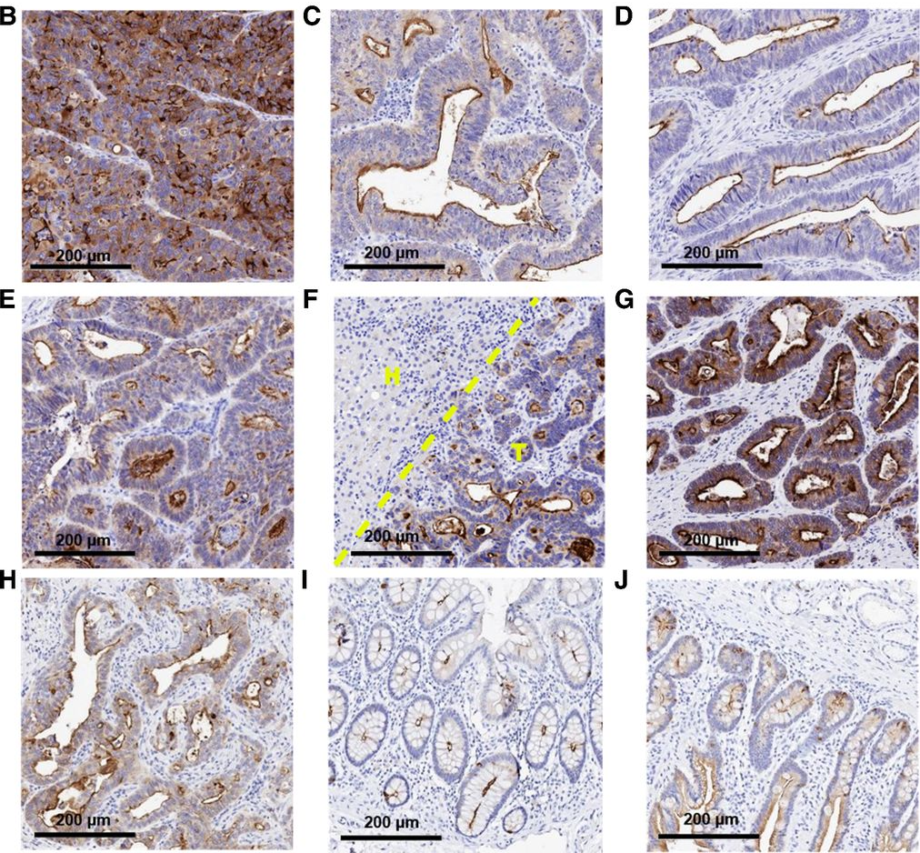
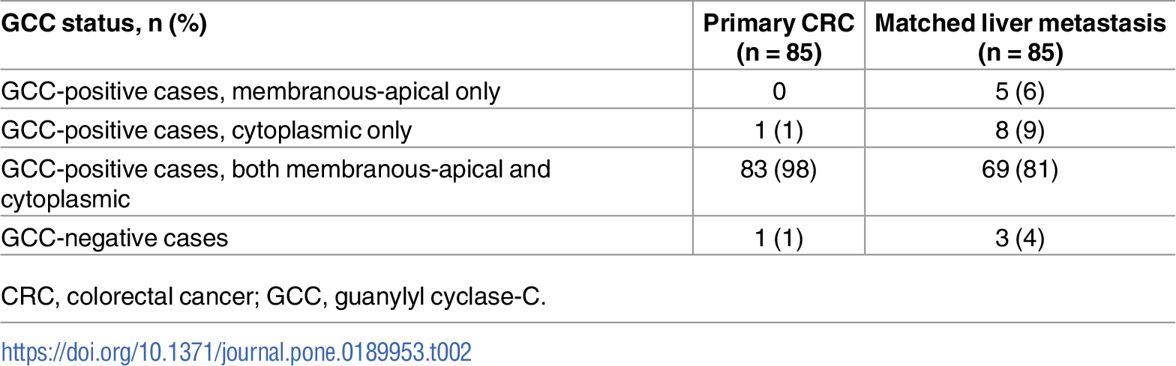
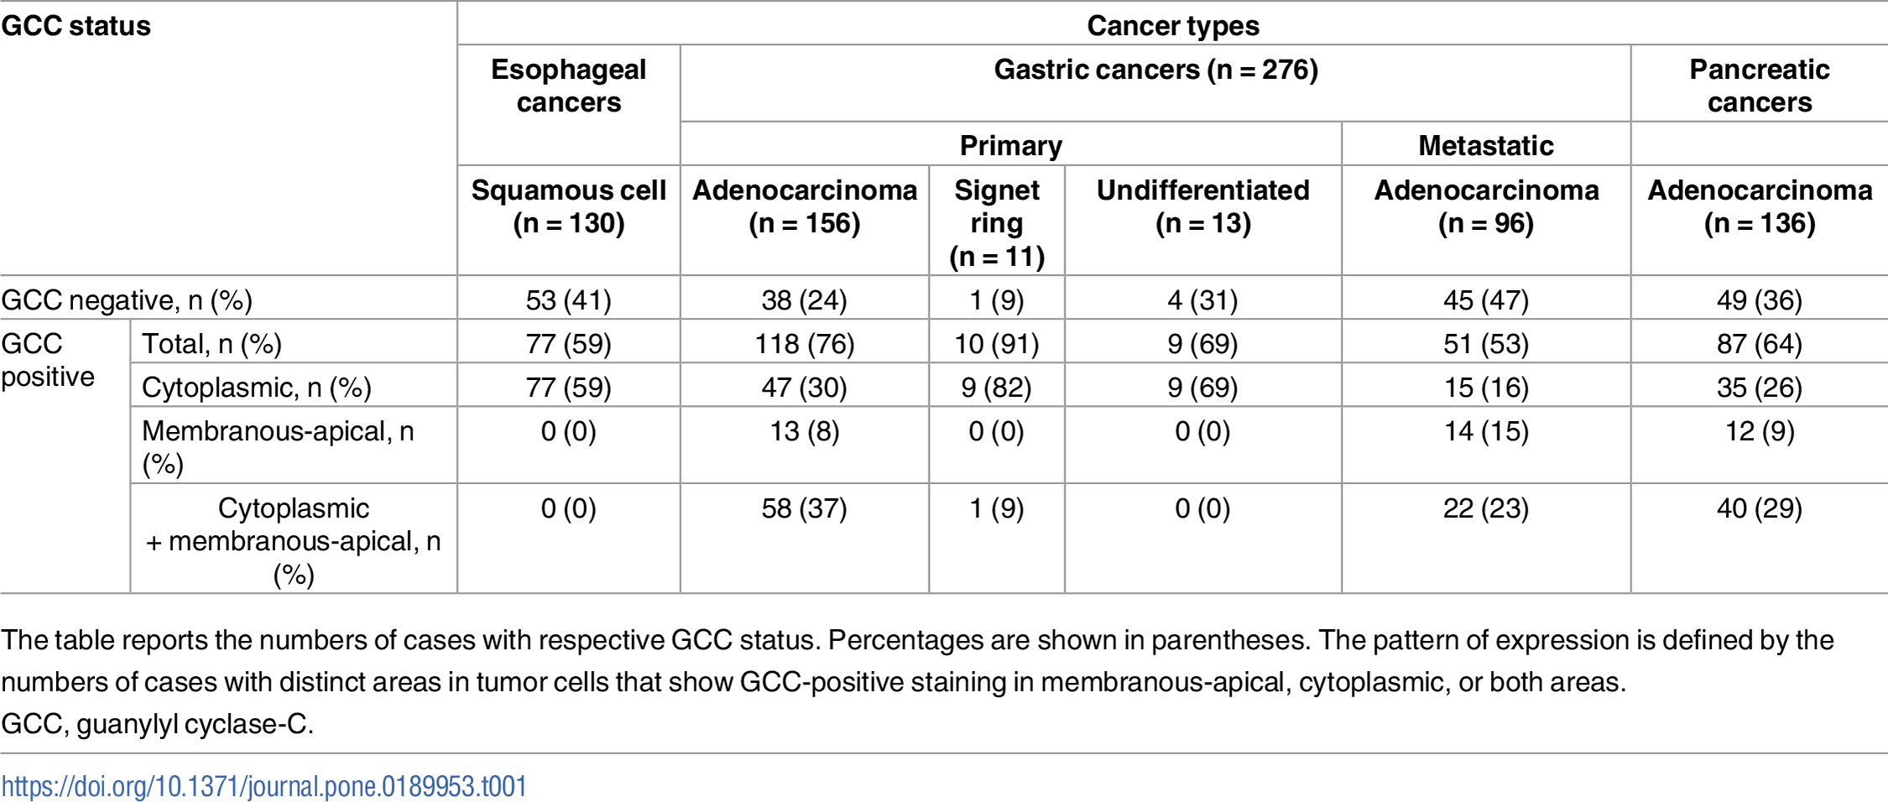
Expression
GCC expression is retained across stages of CRC transformation & metastasis
GCC staining across stages & metastases
GCC expression preserved in most metastases
CRC stage I
CRC stage II
CRC stage III
CRC stage IV
CRC liver met
Gastric adenocarcinoma
Esophageal adenocarcinoma
Normal colon
Normal intestine
Sources: Mathur Clin Cancer Res 2020, Danaee PLOSone 2017
Confidential 7

Slide 8
Expression
GCC is consistently & frequently overexpressed in CRC and beyond
Tumor expression levels
Indication | Type | Method | Criteria | Value | Source
CRC | Protein | IHC | H-score over 100 | 70% (14/20 pts) | Mathur Clin Cancer Res 2020
 | Protein | IHC | 3+ and 2+ | 75%: 3+ staining 35.4% (138/390 pts), 2+ staining 23% (90/390 pts) | Qi J Immunotherapy Cancer 2024
 | Protein | IHC | Positive if >10% cells stained, membranous or membranous & cytoplasm | 98% primary tumor (83/85 pts), 81% matched liver metastasis (69/85 pts) | Danaee PLOSone 2017
Gastric | Protein | IHC | H-score over 100 | 31% (6/19 pts) | Mathur Clin Cancer Res 2020
 | Protein | IHC | Positive if >10% cells stained, membranous or membranous & cytoplasm | 46% primary tumor adenocarcinoma (71/156 pts), 37% metastases adenocarcinoma (36/96 pts) | Danaee PLOSone 2017
Esophageal | Protein | IHC | H-score over 100 | 50% (9/18 pts) | Mathur Clin Cancer Res 2020
Pancreatic | Protein | IHC | Positive if >10% cells stained, membranous or membranous & cytoplasm | 38% adenocarcinoma (52/136 pts) | Danaee PLOSone 2017
All | mRNA | RNAseq | Median pTPM>25 | Strong overexpression in Colon and Rectum datasets; some overexpression in Stomach dataset | TCGA dataset
Healthy tissue expression
 | Type | Method | Criteria | Value | Source
All | Protein | IHC | HPA Medium or High | Medium to High expression in GI tract, brain, and epithelial cells across organs with a single antibody. Qi et al saw significantly less staining in healthy tissues (See back up) | Human protein atlas Qi J Immunother Cancer 2024
All | mRNA | RNAseq | nPTM>10 | Expression in healthy duodenum, small intestine, colon and rectum | Human protein atlas
Confidential 8

Slide 9
Biology
GCC has beneficial traits for an RLT target:
Native peptide ligands, internalization & no shedding into blood
Structure & Function
Native & known peptide ligands
Native receptor for enterotoxins and the endogenous paracrine hormones guanylin and uroguanylin. Ligand binding to the ECD of a GCC dimer catalyzes the conversion of GTP into cGMP and initiates downstream signaling, ultimately leading to the regulation of epithelial cell proliferation, differentiation, and apoptosis.
Internalization
Rapidly internalizes from the cell surface to lysosomes in intestinal and colorectal cancer cells. Endocytosis is independent of ligand binding and receptor activation and is mediated by clathrin. Native internalization ideal for RLT, as isotope would be in close proximity to DNA & contain the daughter ions.
Secretion & Shedding
There is no evidence GCC is secreted or shed.
Sources: Lisby, Expert Rev Precis Med Dru Dev 2021 Marszalowicz Oncotarget 2014
Confidential 9

Slide 10
Landscape
GCC positivity across stages & metastases in CRC creates diverse treatment options
~154,000 new cases and ~53,000 deaths from colorectal cancer in the US in 2025
Stage II/III post-resection, MRD+ patients
Late line mCRC
(≥3L)
Approach | Adjuvant, curative intent monotherapy for post-resection Stage II/III, MRD+ (ctDNA+) patients | Late line monotherapy in Stage IV patients at end of treatment options
Annual incident cases | 154,000 | 154,000
% diagnosed at Stage | 70-80% local/regional | 20% distant
 | ~90% undergo surgery | 25-30% advance to 3rd line
 | ~15% MRD+
% GCC Positive | ~80% | ~80%
Rough estimate TAM: | 12,500 | 7,300
Sources: SEER , Siegel Cancer Journal for Clinicians 2023, Tarpgaard Cancers (Basel) 2023, Abidoye MDPi 2025, Nakamura Nature Med 2024, Upadhyay Ther Adv Med Oncol 2015, Liu Ther Adv Gastero 2022
Confidential 10

Slide 11
Landscape
Example Target Product Profile for GCC-RLT in MRD+, post-resection CRC
Mechanism / Mode of Action | GCC-targeted peptide ligand conjugated to chelated ²²⁵Ac, delivering targeted alpha radiation to eradicate microscopic residual disease.
Clinical Trial Design | Randomized Phase III. GCC-RLT vs. standard adjuvant chemotherapy (CAPOX/FOLFOX) with curative intent.
Indication / Target Patients | Post-resection Stage II (high risk) or Stage III CRC patients who are MRD+ (ctDNA+) as measured 4-8 weeks post-op and prior to receiving adjuvant chemotherapy.
Dosing Regimen & Administration | Intravenous infusion of GCC-RLT for 4 doses, 4 weeks apart, and 2 doses every six months following the initial cycle until progression
Clinical Endpoints | Primary Endpoints: Disease Free Survival (DFS) at 18 or 24 months Secondary & Exploratory Endpoints: mDFS, ctDNA clearance, durability of ctDNA response, overall survival, etc.
Efficacy |  | GCC-RLT | Adjuvant Chemo (CAPOX/FOLFOX)
 | Dosing Schedule | See above | 3-6 mo of standard regimen
 | DFS (18 mo) | >80% | 62%
 | mDFS | >18 mo | 12 mo
 | ctDNA clearance (>18 mo) | >60% | 37% (“sustained clearance”)
 | ctDNA clearance (6 mo) | >75% | 68%
Safety / Tolerability | Grade ≥3 TEAEs Neuropathy risk | <30% Minimal/none | 50-60% 17-48%
Sources: Nakamura Nature Med 2024, Kotani Nature Med 2023, Grothey NEJM 2018
Confidential 11

Slide 12
Opportunity
Sego’s approach to GCC
 | Sego’s Approach
 | Ligand-binding site targeted cyclic peptide | Allosteric cyclic peptide
Modality | Cyclic peptide targeted to the ligand binding site of GCC dimers on the surface of tumor cells | Non-active-site binding cyclic peptide targeting GCC monomers on the surface of tumor cells
Isotope/Payload | ²²⁵Ac or ¹⁶¹Tb | ²²⁵Ac or ¹⁶¹Tb
Internalization | Select for internalizing peptides that internalize with ligand-bound GCC | Select for internalizing peptides that internalize with GCC monomers
Advantage | GCC is selectively blood accessible in tumor cells, both in CRC and in metastases, but not healthy tissue, allowing for a therapeutic window. Native peptide ligands provide a starting point for drug development. | Similar to active site binder, plus this approach effectively doubles available receptor concentration and potential tumor binding of RLT: 1 RLT molecule binds 1 GCC monomer
Confidential 12

